Slide 1
MCSD51: Certificate in Introductory Software Development Level 5
Part 2:
Product Implementation

Slide 2
Password Generator
Maribeth Estimos
Xian (Richard) Zhang
Zhengwen (Steven) Lei

Slide 3
Agenda
1. What is a Password Generator
2. Why we chose this project
3. Technologies
4. Methodology
5. Team work
6. Reflections
7. Demo
8. References
9. Q & A

Slide 4
What is A Password Generator?
Password Generator is a software tool that creates random or customized passwords for users. It helps users create a stronger password that provide greater security for a given type of access.
• These programs produce complex/strong passwords with combinations of numbers, uppercase and lowercase letters, and special characters such as braces, asterisks, and slashes.

Slide 5
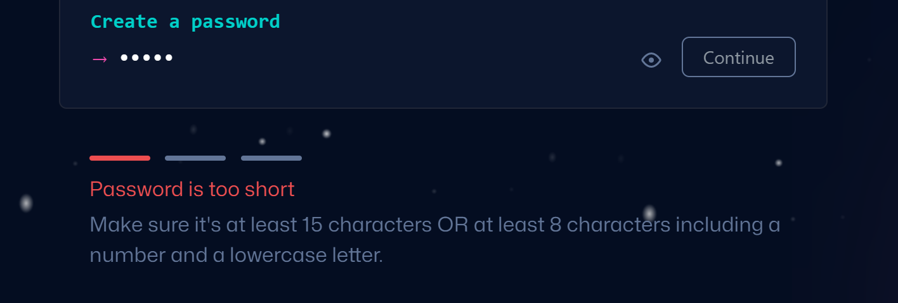
Why we chose this project?
Hard to create a complex password

Slide 6
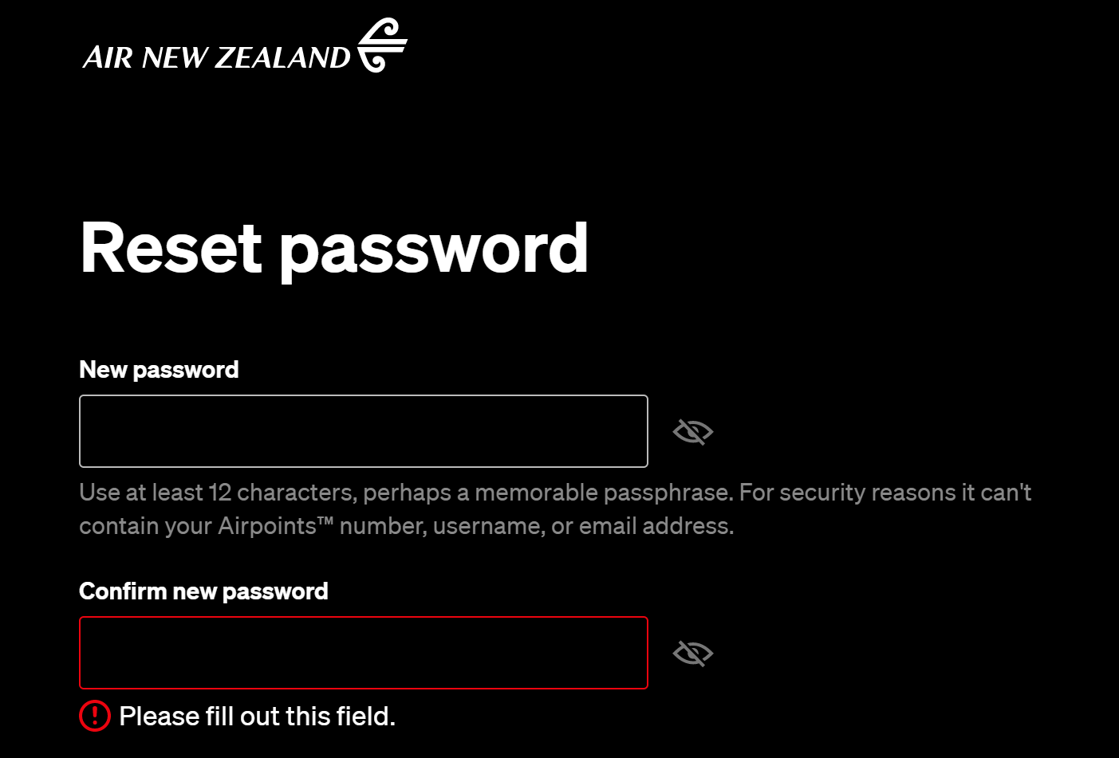
Why we chose this project?
Hard to create a complex password

Slide 7
Why we chose this project?
Users often create simple passwords like these;
123456,1234567890
qwert, qweryuiop
123456qwerty, 1qaz2wsx

Slide 8
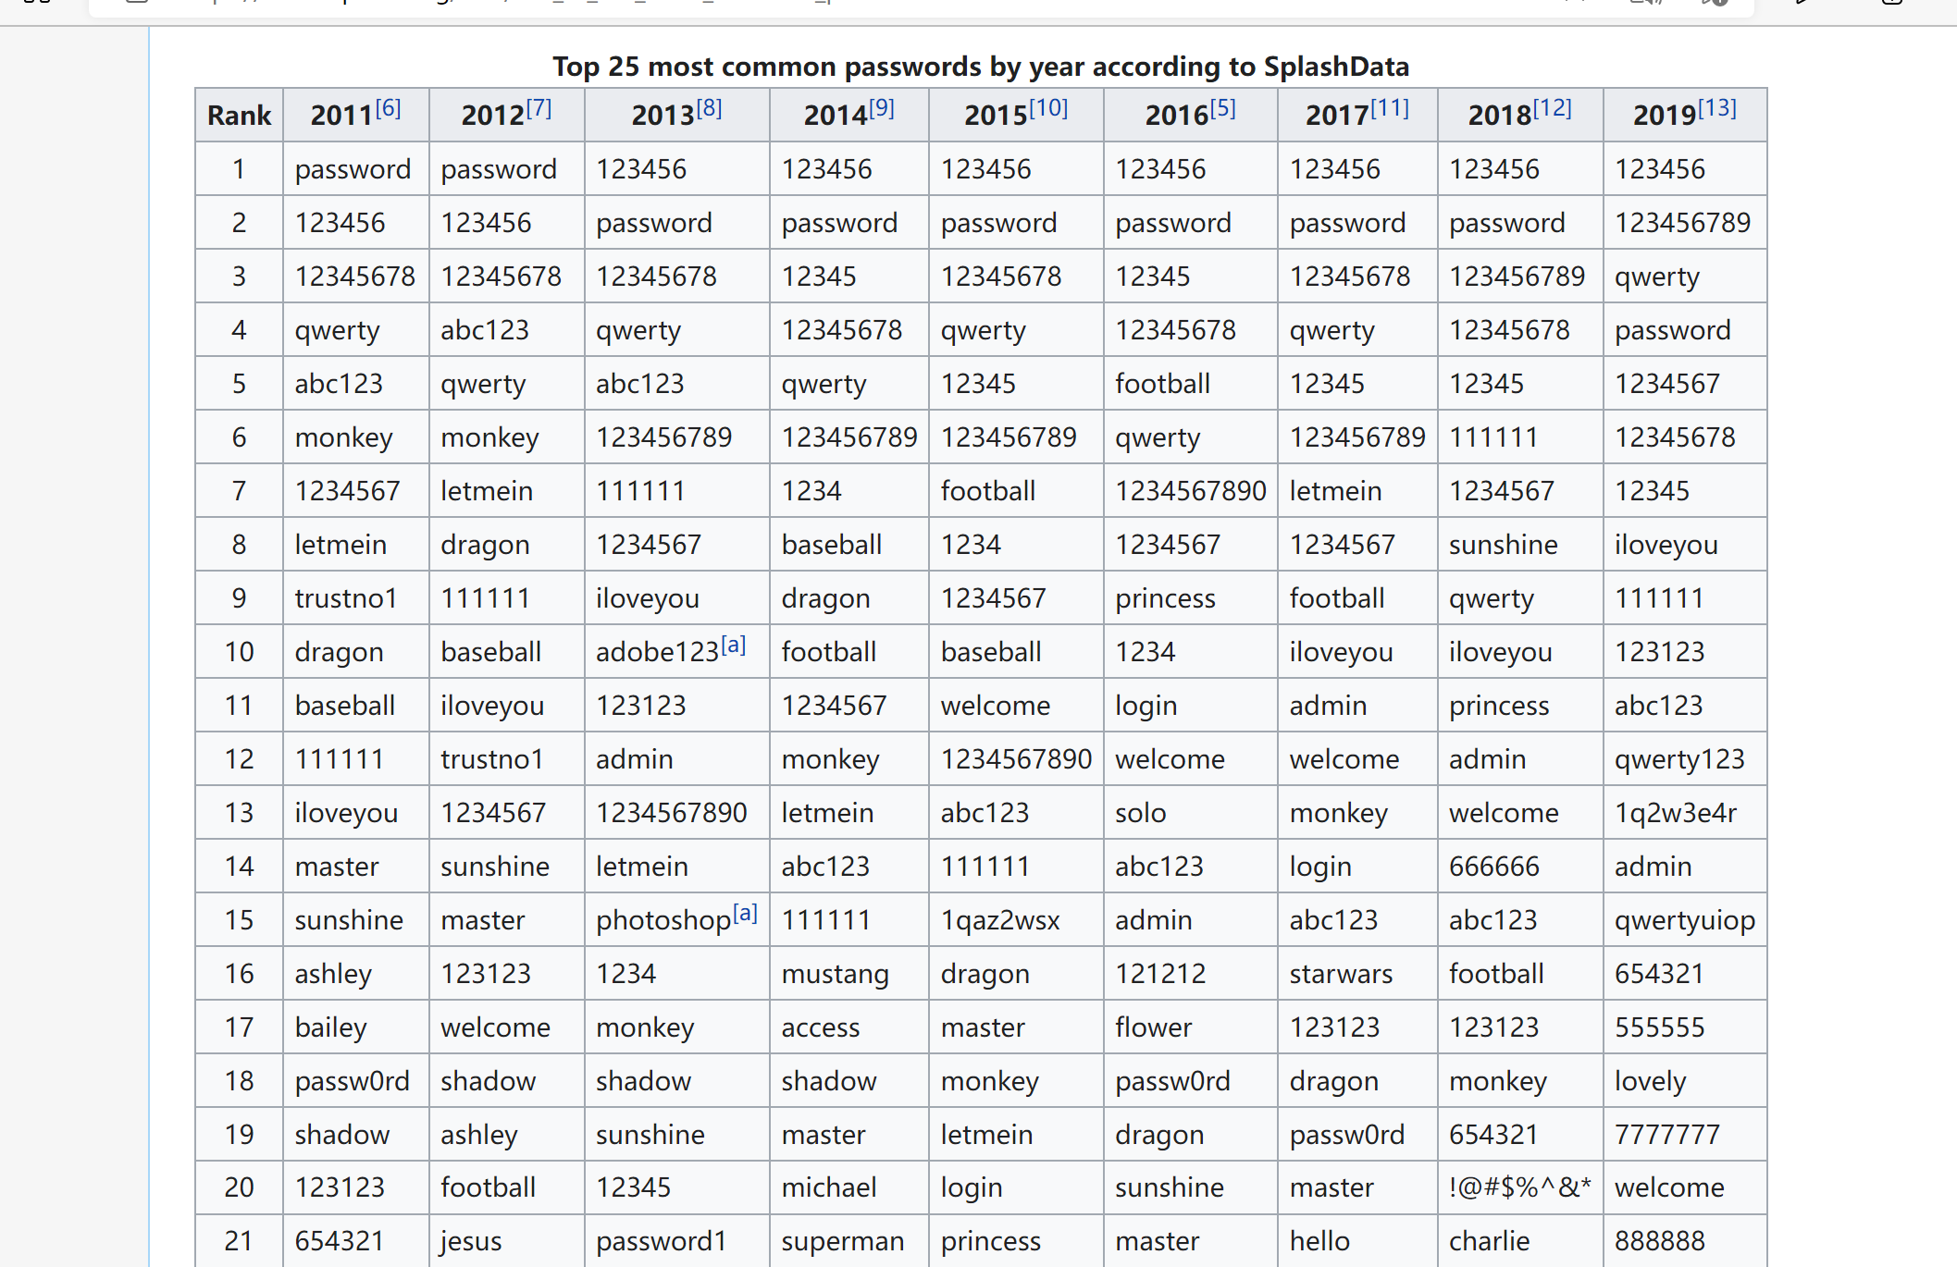
Retrieved from: List of the most common passwords - Wikipedia

Slide 9
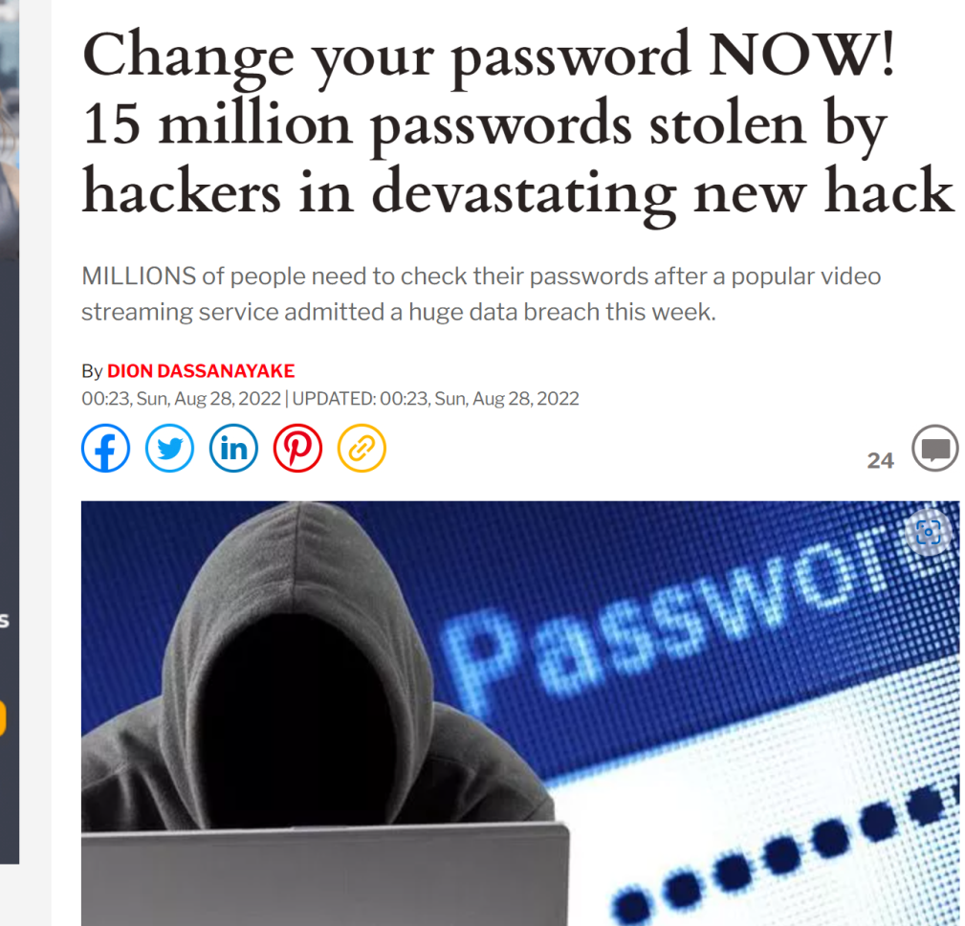
Risks of password leaking
1. Private information exposure
2. Money loss
3. Risks of ID frauds
Retrieved from: Change your password NOW! 15 million Plex passwords stolen by hackers | Express.co.uk

Slide 10
Technologies Used
Web-based software
Tools: Apache, Nodejs
Modules: express, ejs, cookie-parser
Languages: Javascript, Javascript( embedded ), HTML, CSS
Request method: POST / GET

Slide 11
methodology
4 reasons for using waterfall methodology
The requirements are clear.
Relatively simple system.
Only used in certain circumstances
Unlikely to be changed.
1. Allow input of various input parameters on password such as Password Length, Include Special Characters, Numbers, Lower/Upper case Characters
2. Save the settings for future use
3. Generate a random password based on the above parameters
4. Copy function to copy the generated password to the buffer (like Control + C)
Retrieved from: Project list

Slide 12
TEAM WORK
Client (Richard)
User Interface (HTML/ejs, CSS, embedded javascript)
Server (Steven)
request process (javascript)
Cookies process (javascript)
Server( Maribeth)
implement a module for Password Generator (javascript)

Slide 13
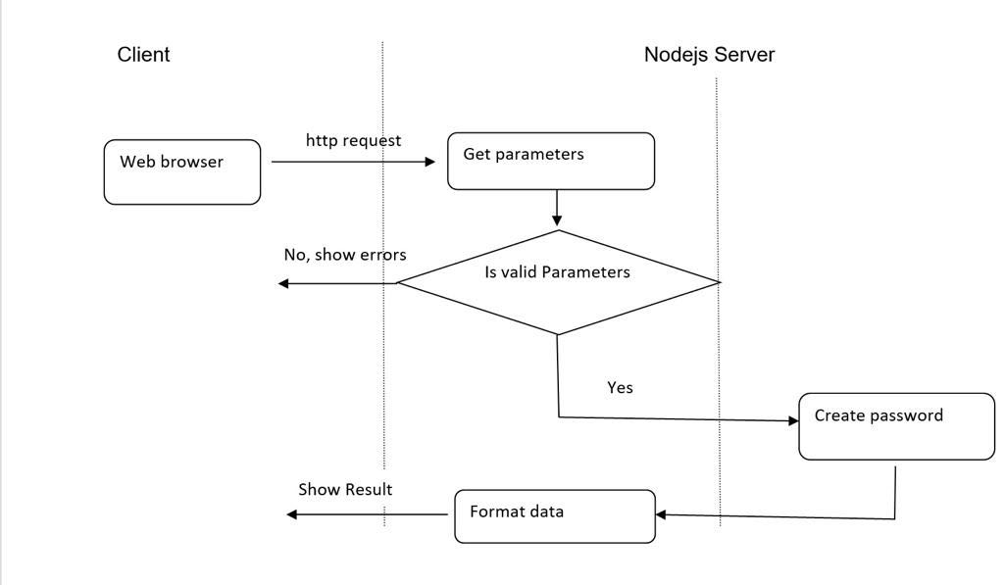
TEAM WORK

Slide 14
Reflections
Maribeth: As I sit down to reflect on my learning journey at Future Skills Academy, I must say that it was a positive one. Being in a different working environment was such a challenge to begin with. I have no clue about the tools, modules and languages at all. I even felt overwhelmed, finding out that we needed to create a program as part of our project. Thankfully, I was put in a group where my team will always check if I needed help and has been very supportive from day 1 up to the final stage. I am very pleased with all the encouragement that they’ve shown me. We worked closely just to ensure that we are all in the same page. By doing this course/project, I gained the knowledge how to use basic CSS and notepad ++. I also learnt about User Story and Use Cases but I guess more than that, I have gained friends and built friendship. It is no secret that there is much more to learn and understand on my end. The learning environment is amazing; lecturers are very supportive and willing to extend help as much as they could.
Richard: It is such a tremendous learning journey for me to code and test the program step by step, and my self-confidence in building the web-based program enhanced gradually. Although, this is a very simple and beginning stage for software development, however, every step and learning experience is fundamentally important for me to grow and learn through firsthand experience.
Steven: I was a programmer and most of my jobs were developing small games. I have basic knowledge with HTML and java scripts. I have never used some tools before such as Nodejs, GitHub, and Gantt charts before this class. Through this course, I managed to use all of these tools. Furthermore, as a team leader of this project, I need to coordinate and work closely with my other team members. For example, when I realised Maribeth couldn’t test her code when the whole project has not finished, I decided to provide a new interface for her – to simply show the result that her function returns on screen. It increases my ability in project management and gained self-confidence. In addition, one of my weaknesses is my English skills. Definitely, by attending this class, my English has improved.

Slide 15
demonstration

Slide 16
References
Future Skills Academy ( August 2022), JavaScript.
What is a Password Generator? (2022),https://www.techopedia.com/definition/31414/password-generator
Why should I use a Password Generator? (Teampassword,27.10.2022), https://teampassword.com/blog/why-should-i-use-a-password-generator
User Stories and Use Cases SDLC – Define Phase: Use Cases 13th June 2022 MCSD51: Prepared by Boon
Ethical and Cultural Impact (Sanam Ghorbani Lyastani et al., 24.12.2017), https://arxiv.org/pdf/1712.08940.pdf%22%20%5Ct%20%22_blank , https://www.sain.ca/publication/thorpePDFS/Do_Password_Managers_Nudge_Secure_Random_Passwords_SOUPS2022.pdf ,https://www.researchgate.net/publication/309467190
Project Management Methodology, Water Fall Methodology Image from Google
https://www.w3schools.com/cs/trycs.php?filename=demo_helloworld

Slide 17
Q&A
Questions and Answers

Slide 18
Thank you everyone!

